Slide 1
The Austrian National eHealth Strategy Overview

Slide 2
Context
Joint strategy by the Federal Ministry, the states and the statutory social insurance bodies
Commissioned by the Federal Target-Based Governance Commission
Strategy process supported by Gesundheit Österreich GmbH (Austrian National Public Health Institute)
Focus: 2030
3

Slide 3
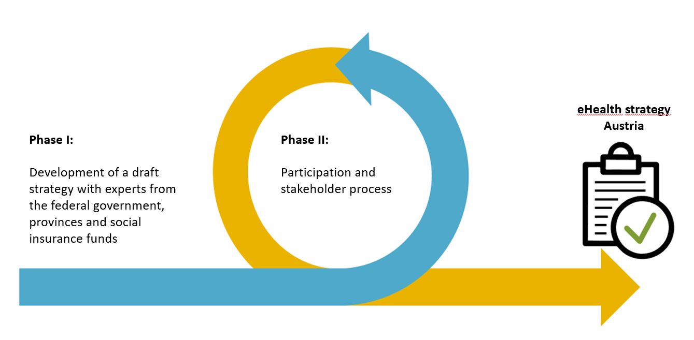
eHealth strategy - process

Slide 4
eHealth Strategy Phase 1
eHealth strategy working group: representatives from the federal government, provinces and social insurance funds
Basis: Existing Austrian and EU-wide strategies and implementation plans
Methodology in the eHealth Strategy Working Group:
Definition of overarching and procedural guiding principles
Developing a vision for the year 2030
Derivation of strategic goals, operational goals and measures aligned with this vision
Prioritization of measures over time
3

Slide 5
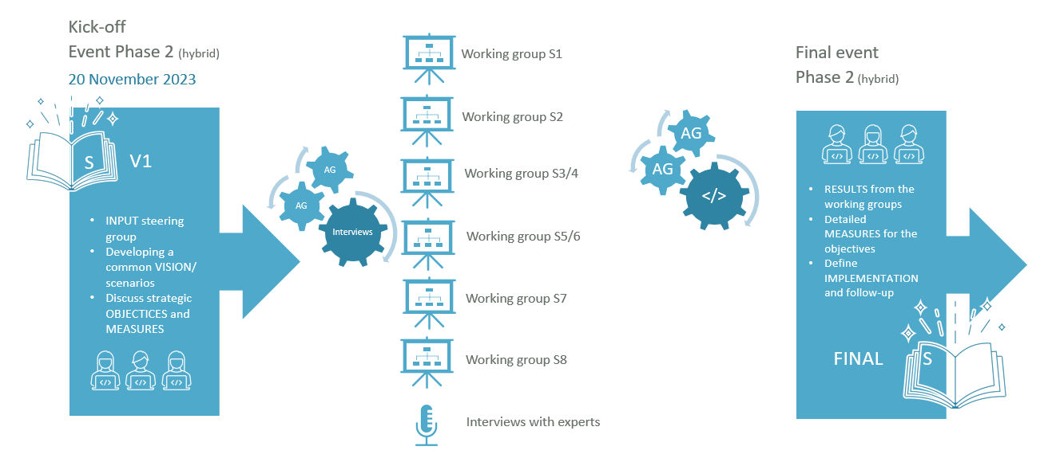
eHealth Strategy Phase 2
4

Slide 6
Guiding Principles
Patients and the quality of care are at the heart of the strategy. Considering both digital and analogue options, the aim is to enhance access and care options in a patient-centred manner and to continuously optimise integrated care
The strategy supports and pursues the idea of a learning healthcare system. This requires the relevant data, monitoring and a strong evaluation culture.
The strategy is a living product and is developed further on a cyclical basis.
In terms of a learning healthcare system, digitalization is not an end in itself, but serves the good of society.
5

Slide 7
eHealth strategy 2030 – strategic goals
S1. Enabling digital access to the healthcare system
S5. Establishing registers relevant for healthcare and governance
S2. Setting up telehealth prevention and care services
S6. Strengthening the secondary use of health data
S3. Extending health telematics infrastructure (HTI)
S7. Making innovation accessible
S4. Providing centralised eHealth services/components
S8. Strengthening digital skills

Slide 8
S8. Strengthening digital skills – Vision 2030
O8.1: Across all healthcare professions, digital skills are an established part of the training and further education programmes for healthcare providers and can be considered a prerequisite for the use of digital tools in the public healthcare system.
O8.2: Citizens in Austria have nationwide access to quality-assured and user-friendly services in the field of digital health literacy.
O8.3: HCPs in Austria enable low-threshold and user-friendly access to digital services and care offerings for all citizens.

Slide 9
Thank you!
Anja Laschkolnig, BA, MPH
Deputy Head – Digital health and data infrastructure
Austrian Public Health Institute

