Slide 1
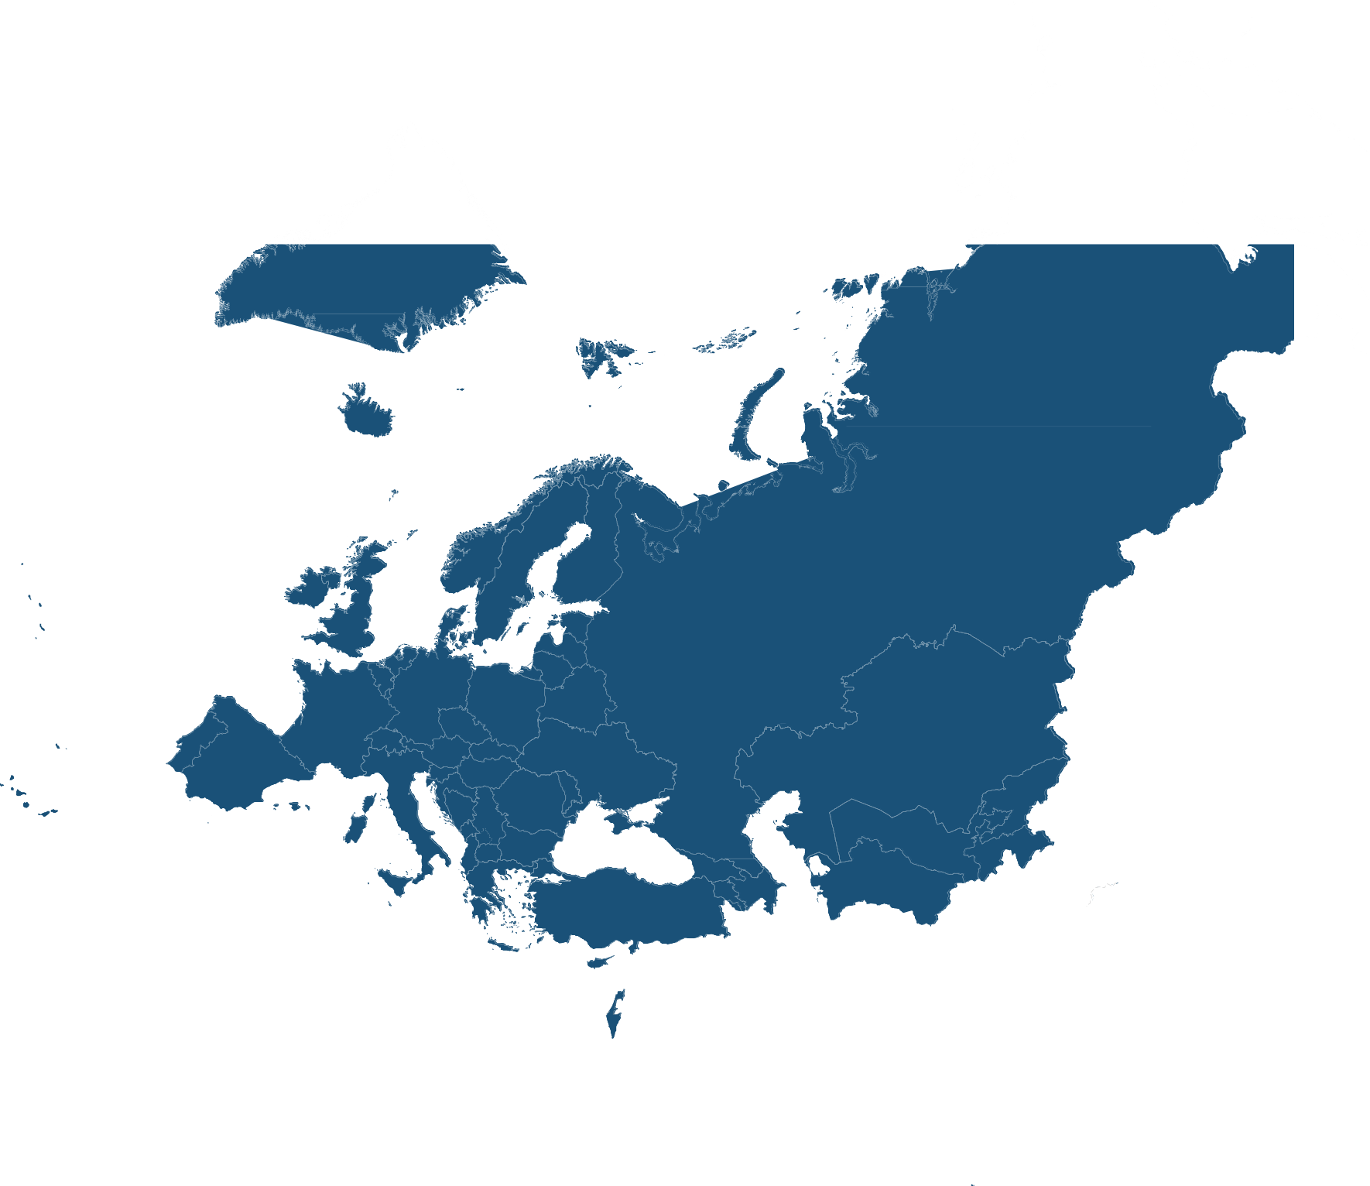





Enhancing Health Literacy & Digital Health literacy:
Regional Digital Health Action Plan 2023-2030
Ryan Dos Santos
Technical Officer – Digital Health
Division of Country Health Policies and Systems
World Health Organization, regional office for Europe
dosr@who.int
Notes:
Digital health literacy is the ability to search, find, understand and evaluate health information from electronic resources and to use the knowledge gained to solve health-related problems.

Slide 2
Regional digital health action plan for the WHO European Region 2023–2030
Regional digital health action plan for the WHO European Region 2023-2030
Strategic objectives
Strategic objectives
Promote commitment to and awareness of digital health
Conduct research and collect available evidence and good practices
Guide the development and adoption of digital technologies
01
02
Enhance or develop national digital health strategies
Assess country capacities in digital health and to align solutions and investments
Support countries to strengthen their capacities to better govern digital transformation in the health sector
Strengthen digital literacy skills
Norms and technical guidance
Country support
RESULTS-ORIENTED
Facilitate advocacy and promote international and multisectoral collaboration
Support the dissemination and exchange of good practices and lessons learned
Establish a platform for dialogue with the private sector
03
04
Monitor developments and trends of digital solutions
Ensure that a people-centred approach is considered as to building trust and facilitating adoption
Develop approaches to the management of health at the population level
Facilitate implementation, evaluation and scale up of digital technologies in the health sector
Networking and knowledge exchange
Horizon scanning and scale up
Notes:
There are several regional focus areas that we have already identified based on our experience in the field, and that we consider important to start including and discussing with you.
First, in regard to the strategic objective 1 related to “Setting norms and providing technical guidance”, we plan to focus on continuing to promote awareness on the importance of digital health; leading research and collecting available evidence, including guiding the development and testing of digital solutions.
If you look at other areas of work, WHO is very well known and recognized and respected for providing technical guidance and high-level advice. However, we acknowledge that a gap exists in the area of digital health, and we are committed to you to ensure that this regional office will take stock of the available evidence –because, of course, there is already technical documents available outside of WHO -- and develop technical guidance so we can support you not only with our expertise but also with the available evidence.
Our regional director, Dr Kluge, and our divisional director, Dr Azzopardi-Muscat, are fully committed to this endeavor, and this is the reason that they decided to establish for the first time a unit on data and digital health.
The second strategic objective, related to direct country support and advance digital health literacy, includes a specific focus on assessing country capacities, and supporting the implementation of the technical guidance that I have mentioned in the first strategic objective. This includes supporting countries in developing or enhancing digital health policies, or at least ensuring that a digital health component is part of an overall national health policy or strategy, and to ensure that digital health is an enabler to achieve national health priorities and goals. In addition, to strengthen digital literacy skills.
For the third strategic objective, related to networking and knowledge exchange, we have ambitious plans:
First, to ensure that we are as much aligned as possible with our key priority partners, the EU and the OECD, so we can leverage the full potential and expertise of our institutions in this area of work in the European region.
Second, to facilitate dissemination and exchange of good practices and lessons learned. As I mentioned before, this is a relatively new area of work if we compare it to areas such as communicable or non-communicable diseases, but we can say that we have some relatively good evidence about practices that work. However, there are large gaps in our learning about what has not worked well when implementing digital health projects, which is something that we should definitely talk more about, and be more open. Therefore, we plan to focus on this and to ensure that this knowledge is shared throughout the region.
And third, we plan to establish a strategic partnership council for digital health to increase knowledge exchange between digital health, life science, and innovation communities and WHO, with the objectives of: creating a dialogue forum to help bridge the public-private divide; helping identify the biggest implementation challenges in the region and where WHO can assist; and assisting in guiding WHO in identifying future strategic priorities for data and digital health.
Finally, moving to strategic objective four, looking at horizon scanning and scaling up, we will focus on monitoring developments and trends of digital solutions, so you can look to us as a primary source of innovation to be up to date in this area of work. Furthermore, we will contribute to facilitating implementation, evaluation and scale up of digital technologies in the health sector. In brief, we expect that when you want to know what is up-and-coming in this field, you can look to WHO for that kind of advice.

Slide 3


Digital Health Literacy in the WHO European Region
(27 out of 52) recognize the importance of digital literacy (17 having developed digital health education action plans, policies and strategies and 10 reported that these were in development)
(28 out of 47) reported they had universities or technical colleges providing students with certified education in digital health
(25 out of 45) also reported that they had developed a digital inclusion plan. for example, a digital literacy programme for disadvantaged populations
52%
60%
56%
Only 71% of the responding Member States (29 of the 41) report that in-service training in digital health is offered as part of continued professional education and even fewer Member States (10 out of 41) consider this training mandatory.
Notes:
Digital health literacy is the ability to search, find, understand and evaluate health information from electronic resources and to use the knowledge gained to solve health-related problems. The importance of digital literacy has been clearly recognized by 52% of responding Member States (27 out of 52), with 17 reporting having developed digital health education action plans, policies and strategies and 10 having reported that these were in development. Additionally, 56% of responding Member States (25 out of 45) reported that they had developed a digital inclusion plan (for example, a digital literacy programme for disadvantaged populations), although responses varied substantially across subregions.
All five central Asian Member States and eight out of the 10 northern Member States reported digital inclusion plans, but in the other subregions less than 50% of the responding Member States reported such plans. A similarly uneven picture across subregions emerges from the responses on digital health education action plans, policies and strategies.
As acknowledged in the Regional digital health action plan for the WHO European Region 2023–2030 (8), developing the digital literacy of the existing health-care workforce is as important as the education and training of those at the start of their careers. There has been minimal research into health-care staff digital literacy levels, with the findings of the studies that have been conducted generally demonstrating that while most health-care professionals use digital health solutions in clinical settings, such as EHRs, many of them still do not feel competent in their overall digital health skills.
The WHO Regional survey 2022 also asked to which professional groups the training was offered. Replies cover all seven of the groups listed in the survey, with the majority of Member States offering in-service training to medical professionals followed by nursing and midwifery and public health specialists. Few Member States offer in-service training for pharmacists. Several other professional groups were also mentioned: allied medical professionals, and those working in mental health and occupational medicine.
Compared to 2015, the questions posed in the 2022 survey were limited to digital health education and did not include information and communication technology (ICT) training, as most of this training today typically takes place in primary and secondary schools. Nonetheless, when the two surveys were compared, no major change over time in the type of in service training available to health professionals was observed.
The World Health Organization estimates overall demand for healthcare workers to rise to 18.2 million across Europe by 2030 and, as an example, states that the current supply of 8.6 million nurses, midwives, and healthcare assistants across Europe will not meet current or projected future need.

Slide 4
Responsibility
Decision makers have a role in ensuring that users have enough digital skills to interact with and use the digital solutions they deploy in the public domain.
There is also the need to ensure equity when deploying digital solutions
Another important aspect of this responsibility, of course, is that leadership needs to recognize the importance of a multi-stakeholder approach and ensure the inclusion of the population and HWF to ensure their needs are met.
Digital Health literacy needs to be included in all aspects of healthcare, from regular inclusion in curricula to sustained in-service training.
Strategy, Policy, Governance.
​

Slide 5
WHO Regional Office Response
Ongoing work to take stock of the available tools to measure DHL in the population and the HWF
  Scoping review of available tools to measure digital health literacy in the population + policy recommendations for the way forward – Global scope
  Scoping review of available tools to measure digital health literacy in the health workforce + policy recommendations for the way forward
Our fellowship on health informatics with the CDC – iDash, iLead, i4L .
  IDASH 1-year fellowship in Informatics and Data Science for Health – technical officers
  ILEAD Inter-governmental Learning Exchange to Advance Data-driven Decision-making – managers
  I4L Informatics For Leaders Summit – executives – Deputy Ministers. Next cohort -8 countries- including UKR and Central Asian Republics
The capacity building components– Impact training on Big Data and analytics, HIS Assessment, and Capacity building in GIS.
EPW 2.0 (2025-2030) – Health Systems of the Future

Slide 6


Thank you
The ongoing journey to commitment and transformation - Digital Health in the European Region 2023
For more information, please contact:
Data, Evidence and Digital Health Unit
Division of Country Health Policies and Systems
World Health Organization, regional office for Europe
dosr@who.int
Relevant links:
Regional digital health action plan for the WHO European Region 2023–2030
Resolution “Leveraging digital transformation for better health in Europe”.
Support tool to strengthen health information systems

