Slide 1
Digital health literacy on the population level – What do we know, what do we need? M-POHL EVPOP Workshop February 20, 2025
Prof. Diane Levin-Zamir, PhD, MPH, MCHES
Director (emeritus), National Dept of Health Promotion, Clalit Health Services, Israel
Full Professor, University of Haifa – School of Public Health, Israel
Co-chair for Research – WHO Action Network for M-POHL
Chair, National Council on Health Promotion, Israel Ministry of Health
IUHPE – Global Working Group Health Literacy Leadership
1

Slide 2
Presentation Overview
Setting the scene:
Digital Health literacy - The evolving definition
Why is it important?
How and why can we measure
The results of the M-POHL study on DHL
New challenges for DHL in the AI era
Final reflection
2

Slide 3
Digital Health
the use of technology, such as mobile devices, wearable sensors, and electronic health records, to improve health and healthcare.
includes a wide range of applications, including telemedicine, digital therapeutics, health information technology, and mobile health.
can be used to monitor health, provide health information
and education, diagnose/treat diseases, and manage
chronic conditions.
The goal: to improve patient outcomes, increase quality and access to care, and reduce healthcare costs. WHO 2016/2020
3

Slide 4
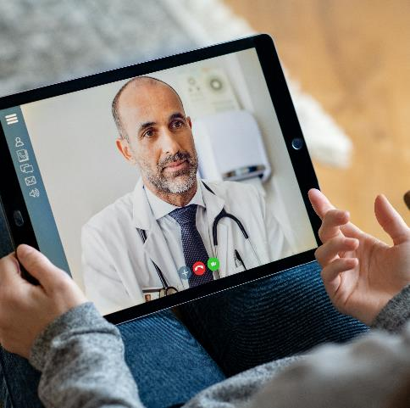
Advantages of Digital Health
Overcomes distances
Overcomes language barriers
Conveys real-time information
Overcomes patient-provider barriers
Can expedite the navigation of health services
Can be cost-effective
4

Slide 5
Barriers to Digital Health
Privacy and confidentiality
Credibility and trust
Usability
Accessibility – Broadband, etc
Common language
5

Slide 6
Nudge or Sludge?

Slide 7
VR Utilization in Healthcare
MENTAL & PHYSICAL REHABILITATION

Slide 8
Maximizing the benefits of health technologies
Digital health literacy allows individuals to effectively use digital platforms (mobile apps, telehealth, wearables and online services)
8

Slide 9
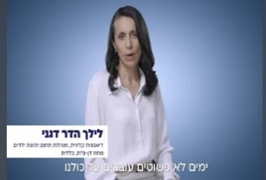
Health literacy in times of crisis through social media
6 videos were immediately produced and released to promote coping with emergency through healthy lifestyle
Maintaining smoking cessation
Physical activity for young families
Family nutrition
Physical activity for older adults
Mindfulness
Healthy sleeping
Response: Over 620,000 hits

Slide 10
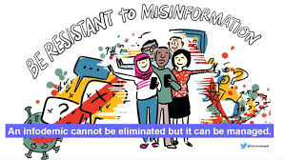
Info-demics - The case for critical Digital Health Literacy
Spreading of misinformation
May be as harmful as the disease itself, impeding public health responses.
Fabrication may be intentional or unintentional.
Reflects the public’s thirst for knowledge and solutions
10

Slide 11
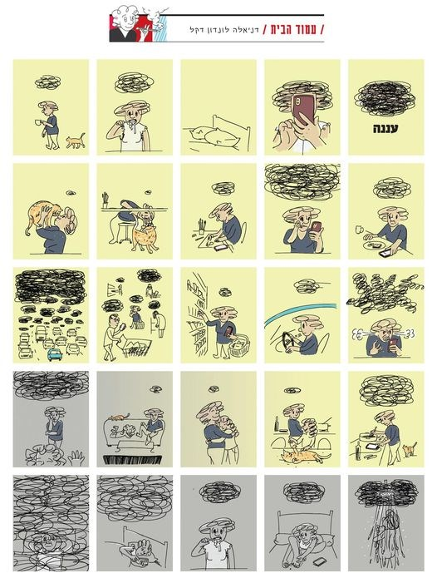
Mental health: Everyone
has a “cloud”
Notes:
רונן

Slide 12
Online Health Promotion Workshops -
Healthy lifestyle & weight loss
Smoking cessation
Preparation for birth and parenting
Breastfeeding
Mindfulness
Self-care and healthy lifestyle for people with diabetes
Surrogate parenting
Providing a secure space for promoting health in times of conflict

Slide 13
Digital Health Literacy as an Asset
Digital Divide or Digital Development throughout the life course?
13

Slide 14
The complexity of Digital Health Literacy
14
Levin-Zamir, D. & Bertschi, I. 2018, Int. J. Environ Res Public Health, 15, 1643

Slide 15
The challenge
The increasing access of health-related digital resources, places a growing demand for population Digital Health Literacy (DHL) to adequately use these resources.

Slide 16
Measuring Digital Health Literacy for general adult population in the Health Literacy Survey (HLS₁₉) of the WHO Action Network M-POHL
Diane Levin-Zamir, Stephan Van den Broucke, Jürgen M. Pelikan, Robert Griebler, Thomas Link, Christa Straßmayr for the Working Group on Digital HL in HLS₁₉
16

Slide 17
Digital Health Literacy- Developing and applying a measure
The WHO M-POHL HLS19 consortium defined DHL as: “the ability to search for, access, understand, appraise, validate, and apply online health information, and to formulate/express questions, opinion, thoughts, or feelings when using digital resources”.
The objective of the study: to construct and validate a DHL measure across countries in Europe, and to identify determinants and consequences

Slide 18
Methods
DHL measures were constructed with 8 items regarding skills for dealing with digital health resources (DIGI-HI) and 2 items (DIGI-INT) for interactive use of these resources and applied in 13 countries: Austria, Belgium, Czech Republic, Denmark, France, Germany, Hungary, Ireland, Israel, Norway, Portugal, Slovakia, and Switzerland
Data collection included CAPI, CATI, CAWI, PAPI methods, and mixed formats
Analyses were based on 29,060 respondents from representative samples of 1,000- 3,602/country.
A standardized score was calculated for DHL by combined “very easy” and “easy” responses, range: 0-100.
Multi-variable linear regression models were applied for estimating determinants and outcomes of DHL

Slide 19
Results – psychometrics, determinants and outcomes
For DIGI-HI The ranked difficulty of tasks across countries varies between 22% -54% with particular difficulty in critically judging the reliability of digital health resources.
Internal consistency was high with a Cronbach’s alpha score= 0.83, (range: 0.77- 0.87/country).
The DHL scale was sufficiently unidimensional based on principal component analysis (PCA) of Rasch model residuals combined with dependent t-tests.
Financial deprivation ß=-0.15 (range: 0.08-0.27, significant for 10 countries), age ß=-0.13 (range-0.15 -0.26; significant for 6 countries), and self reported social status : ß=0.08 (range: 0.05-0.13; significant for 10 countries) were DHL determinants for most countries;
For outcomes of self-perceived health, DHL was significant for 9 countries (ß=-0.05 or -0.10) and for visits to GP/family physician in 7 countries (ß between -0.07 and -0.11).

Slide 20
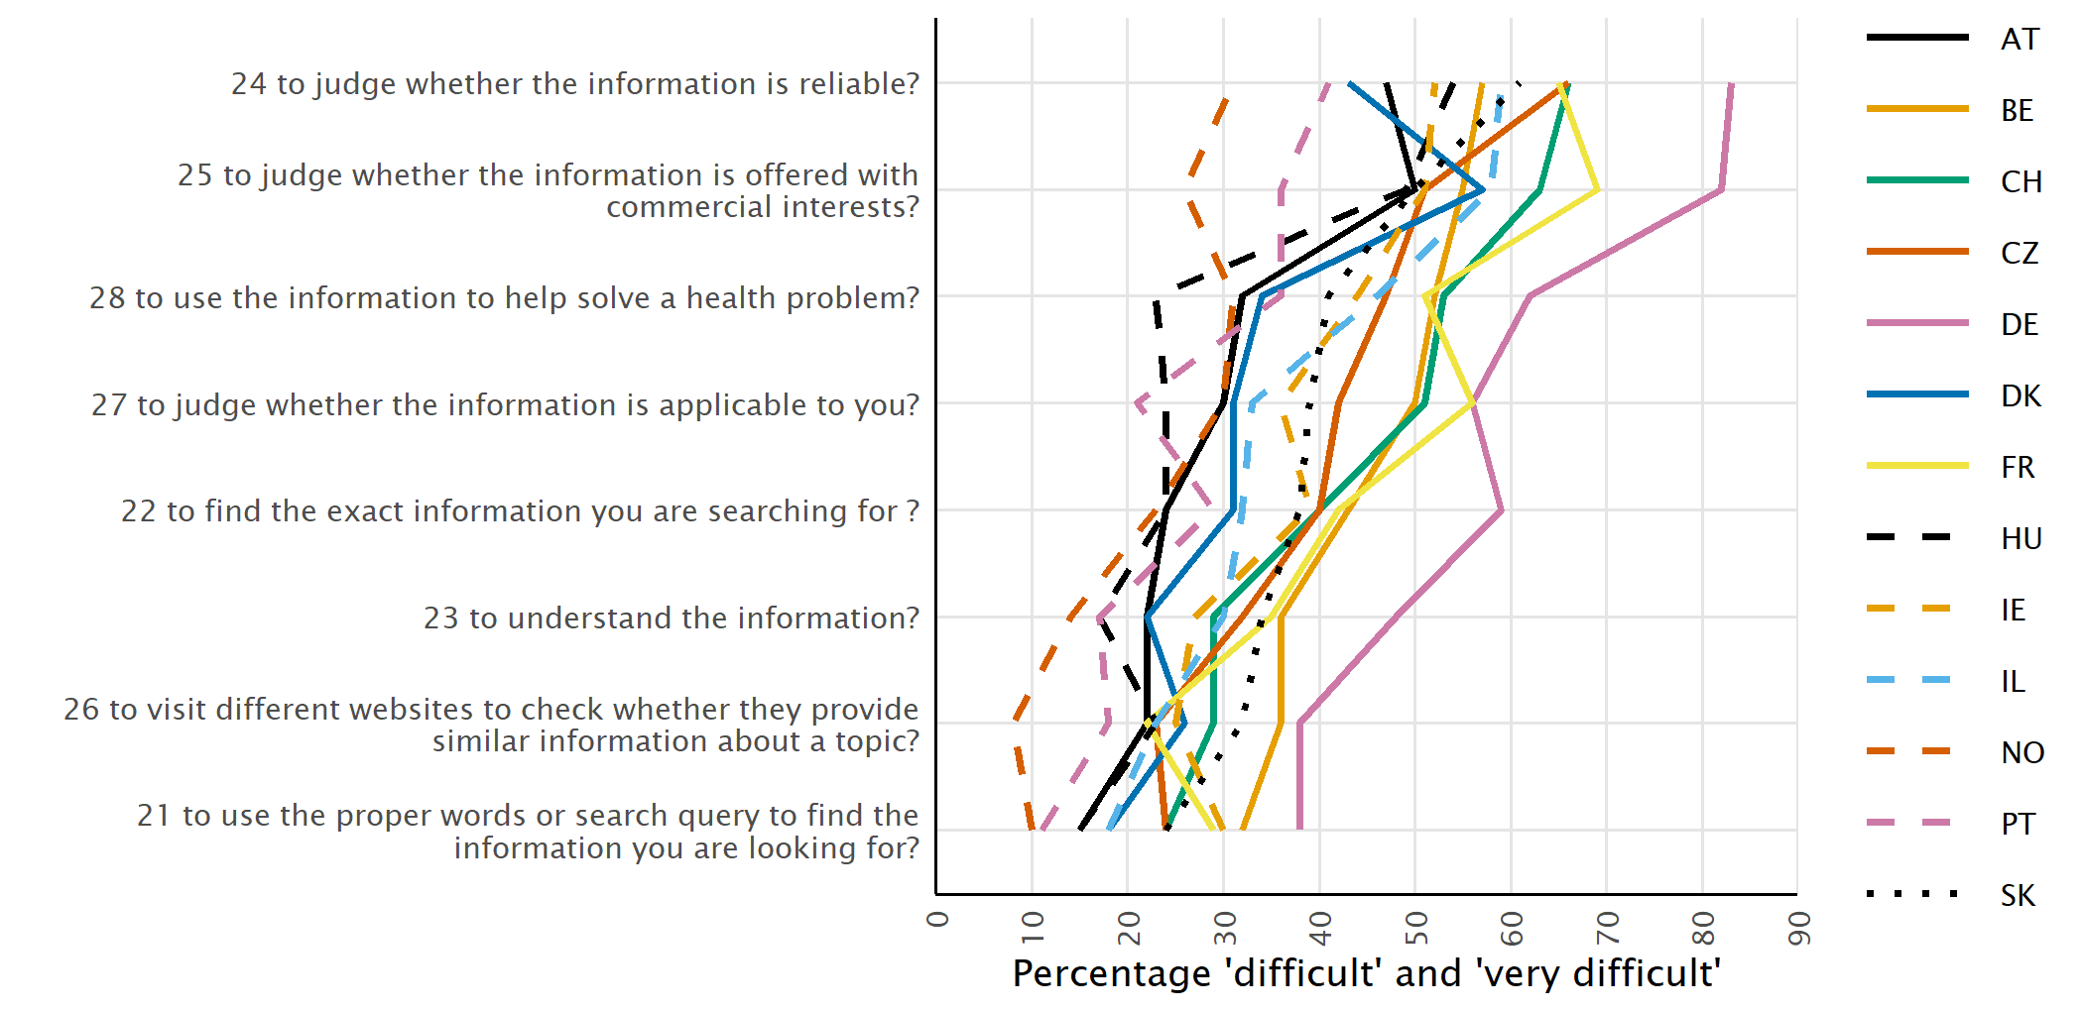
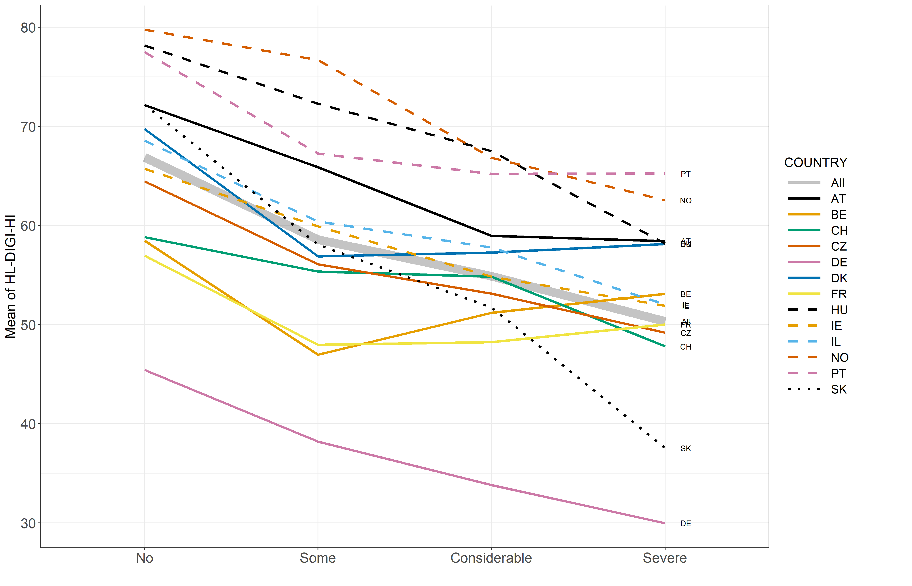
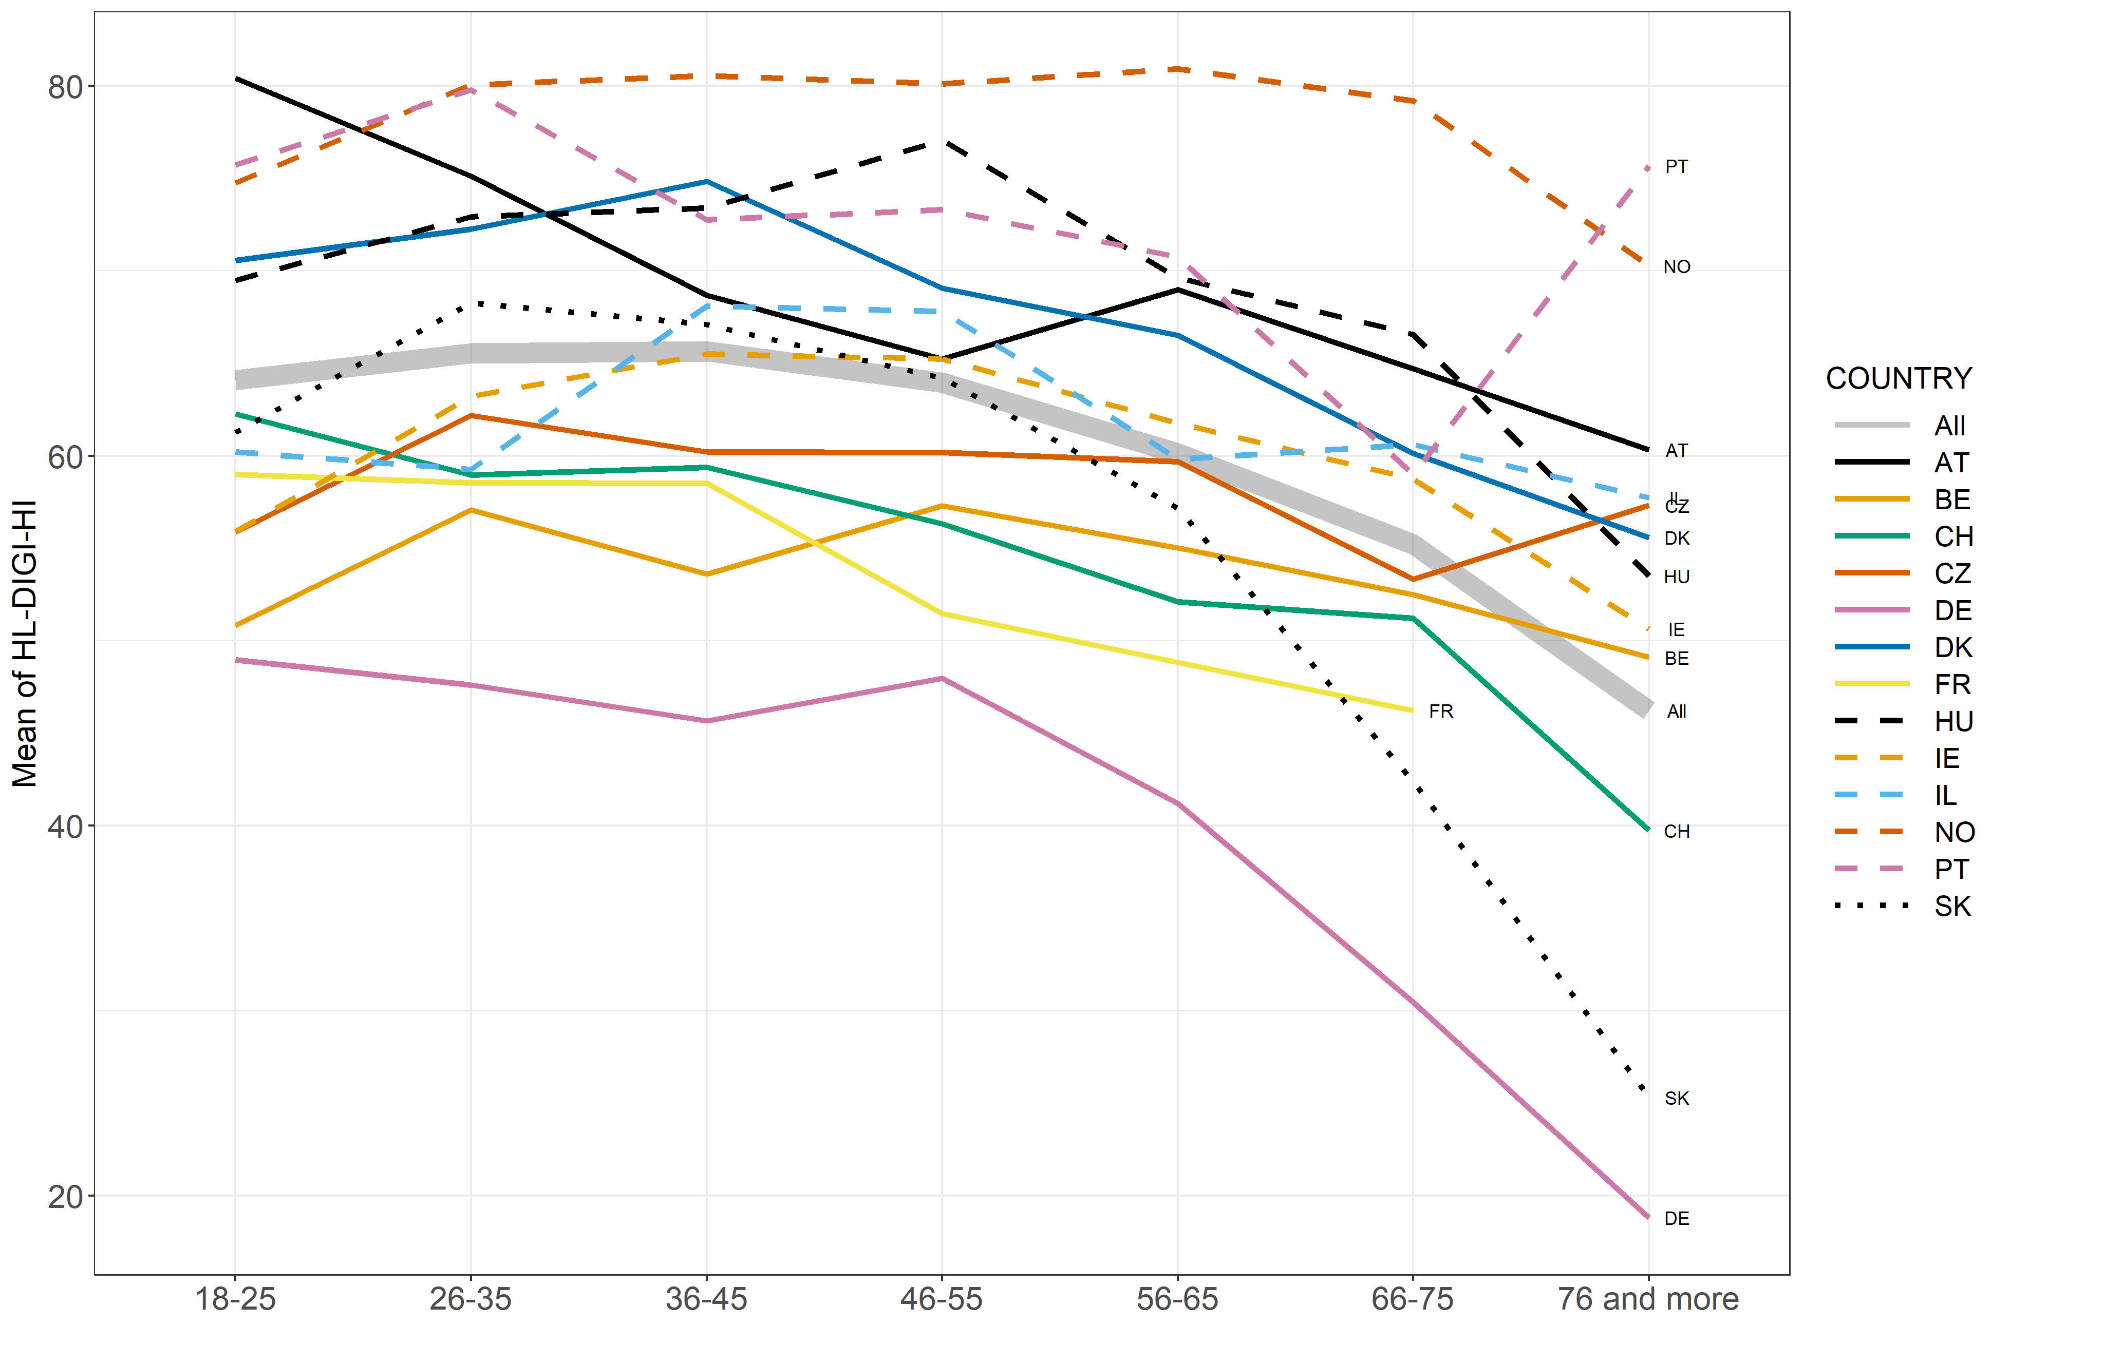
Selected Results
Challenges in Critical DHL
Financial deprivation
Age

Slide 21
In summing up….
Digital health literacy (DHL) is increasingly important in helping people access health information, interact with health and public systems, including navigation and to manage their personal and family’s health.
DHL entails skills related to all aspects of health literacy – functional, interactive and critical.
Social, cultural and generational contexts play an important role in influencing DHL skills.
Appropriate and innovative interventions can positively influence DHL, and contribute to health and well-being.
The principles defined in the UN Sustainable Development Goals must be applied to ensure that in the digitalized world, no one is left behind.
21

Slide 22
On the horizon…
A new updated version of measuring DHL – more precise and includes AI in HLS₂₄.
Stay tuned!

Slide 23
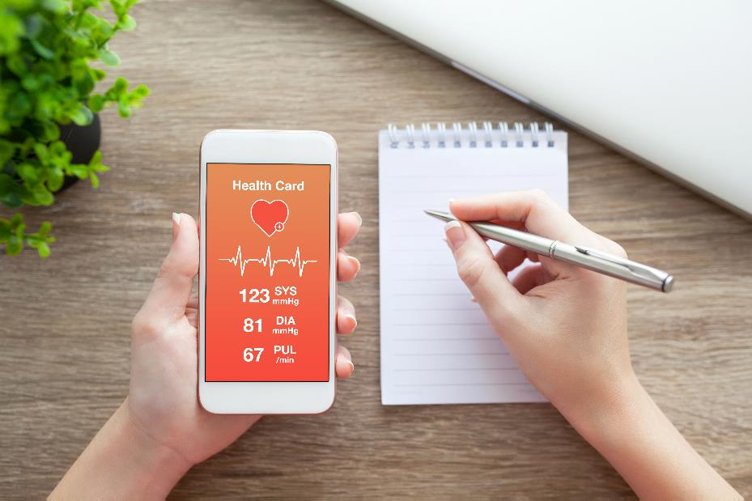
Questions/comments?
23

Slide 24
Thank you for your attention!
For more information: diamos@zahav.net.il
24

